Slide 1
Web Technologies
HTML Basics

Slide 2
Summary of Today’s Lecture
HTML Introduction
HTML and XHTML
HTML Elements
Block level vs Inline Elements
HTML Page Structure
Example HTML Tags
HTML Validator

Slide 3
HTML Introduction
Hypertext Markup Language (HTML) is the standard markup language for documents designed to be displayed in a web browser.
Markup Language is like a blueprint or layout for the processing and appearance of text documents.
In HTML, tags are used to specify the layout or the way to how subsequent line must appear.
The first publicly available description of HTML was a document called "HTML Tags", first mentioned on the Internet by Tim Berners-Lee in late 1991.
It was formally defined as such by the Internet Engineering Task Force (IETF) with the mid-1993.
HTML 2.0 was published as an IETF recommendation in November 1995.
HTML 3.2 was published as a W3C recommendation in January 1997.
HTML 4.0 was published as a W3C recommendation in December 1997.
HTML 5.0 was published as a W3C recommendation in October 2014.

Slide 4
HTML and XHTML
HTML, HyperText Markup Language, gives content structure and meaning by defining that content, for example, headings, paragraphs, or images.
Problem with loose HTML is that lack of standard means that different browsers could display pages in different ways.
XHTML (eXtensible HyperText Markup Language) is a more restrictive form of HTML, adhering to the XML standards (eXtensible Markup Language).
For many years there was a push to develop in strict XHTML format instead of looser HTML, but with little success.
Following are the requirements if an HTML document has to conform with XHTML standards.
<!DOCTYPE> is mandatory
The xmlns attribute in <html> is mandatory
<html>, <head>, <title>, and <body> are mandatory
Elements must always be properly nested
Elements must always be closed
Elements must always be in lowercase
Attribute names must always be in lowercase
Attribute values must always be quoted
Attribute minimization is forbidden

Slide 5
HTML Elements
An HTML element is defined by a start tag, some content, and an end tag.
Syntax: <tagname>Content goes here..</tagname>
Example: <p>This is a paragraph</p>
Some tags can contain additional information called attributes
Syntax: <tagname attribute="value" attribute="value"> content </ tagname>
Example: <a href="page2.html">Next page</a>
Some tags don't contain content; can be opened and closed in one tag. These tags are known as singleton tags.
Syntax: <element attribute="value" attribute="value" />
Example: <img src="bunny.jpg" alt="pic from Easter" />

Slide 6
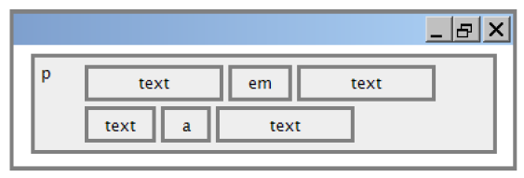
Block-Level vs Inline Elements
Every HTML element has a default display value depending on what type of element it is.
A block-level element always starts on a new line and takes up the full width available (stretches out to the left and right as far as it can).
Examples: div, paragraphs, lists, etc
An inline element does not start on a new line and only takes up as much width as necessary.
Examples: span, bold text, images etc

Slide 7
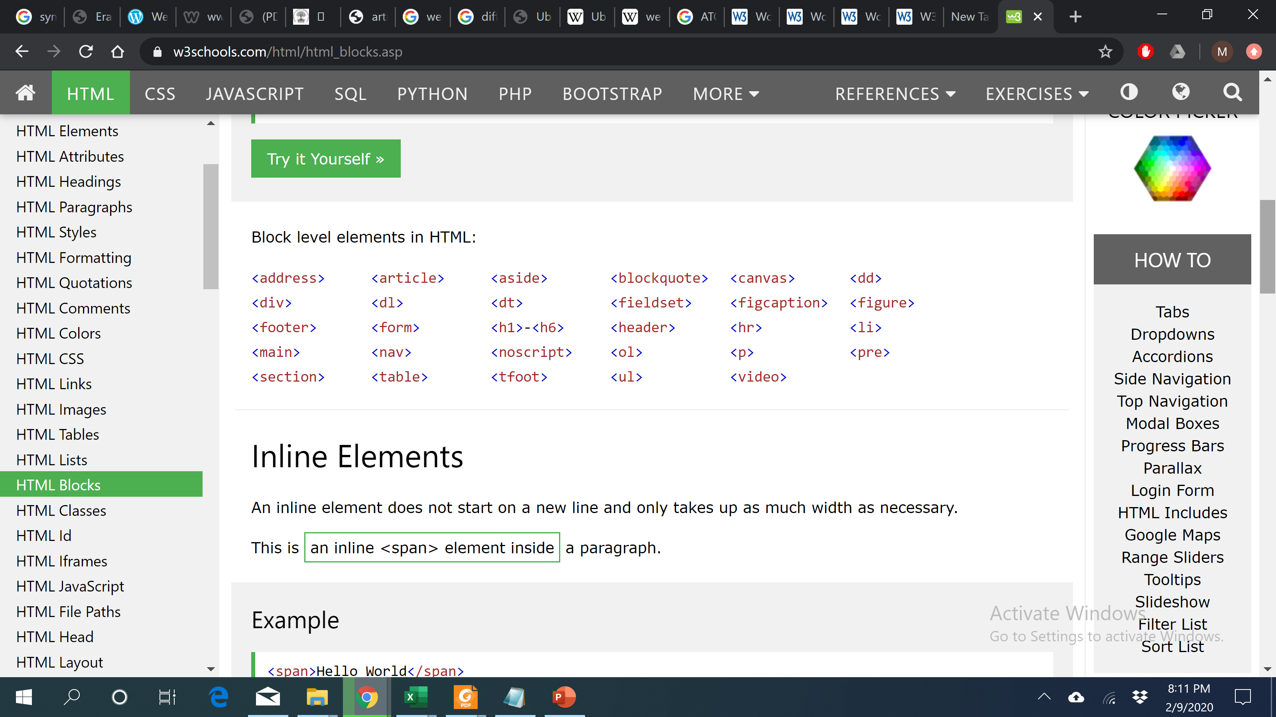
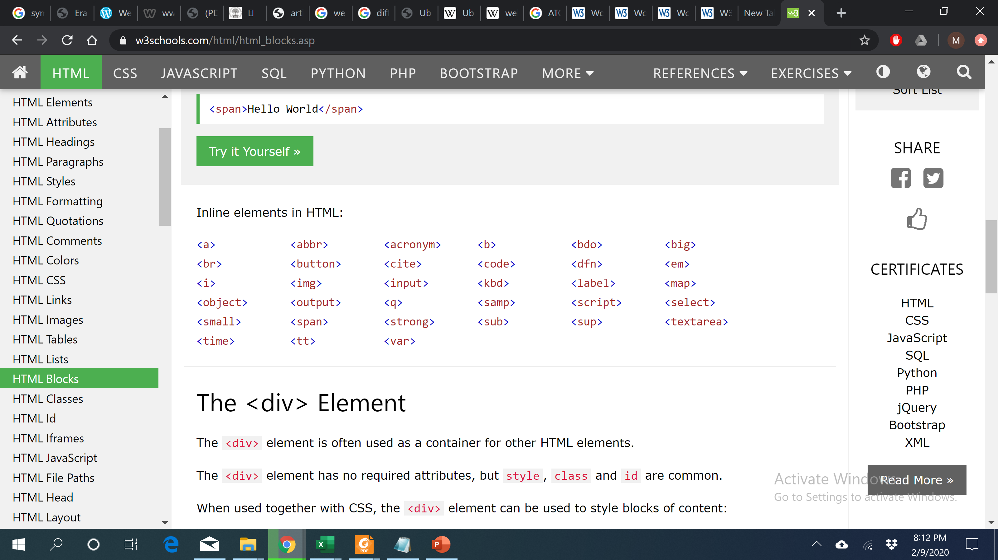
Block-level vs Inline Elements

Slide 8
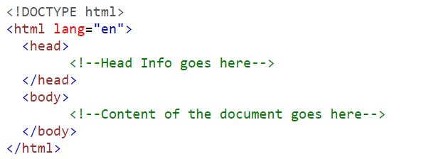
Structure of HMTL page
The <html> tag represents the root of an HTML document.
The <html> tag is the container for all other HTML elements (except for the <!DOCTYPE> tag).
You should always include the lang attribute inside the <html> tag, to declare the language of the Web page. This is meant to assist search engines and browsers.
The header describes the page, and the body contains the page's contents.
An HTML page is saved into a file ending with extension .html

Slide 9
HTML <head> Tag
The HTML <head> element is a container for the following elements: <title>, <style>, <meta>, <link>, <script>, and <base>.
The <head> element is a container for metadata (data about data) and is placed between the <html> tag and the <body> tag.
HTML metadata is data about the HTML document. Metadata is not displayed.
Metadata typically define the document title, character set, styles, scripts, and other meta information.
For the following meta tags describes the content of Web Page using keywords and author of the web page respectively.
<meta name= "keywords" content= " HTML, CSS, XML, JavaScript ">
<meta name="author" content="John Doe">

Slide 10
HTML <title> Tag
The <title> tag defines the title of the document.
The title must be text-only, and it is shown in the browser's title bar or in the page's tab.
It is placed within the head of the page
The <title> element:
defines a title in the browser toolbar.
provides a title for the page when it is added to favorites.
displays a title for the page in search-engine results.
Here are some tips for creating good titles:
Go for a longer, descriptive title (avoid one- or two-word titles).
Search engines will display about 50-60 characters of the title, so try not to have titles longer than that.
Do not use just a list of words as the title (this may reduce the page's position in search results).

Slide 11
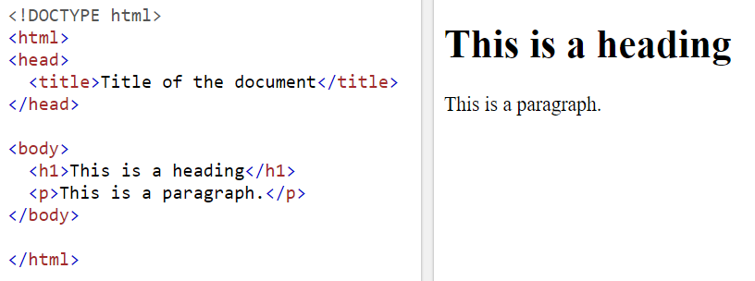
HTML <body> Tag
The <body> tag defines the document's body.
The <body> element contains all the contents of an HTML document, such as headings, paragraphs, images, hyperlinks, tables, lists, etc.
Once the text file has been saved with the extension .html it can then be opened in a web browser.
Every time an html file is altered it has to be saved before the changes can be viewed through a browser.
There can only be one <body> element in an HTML document.

Slide 12
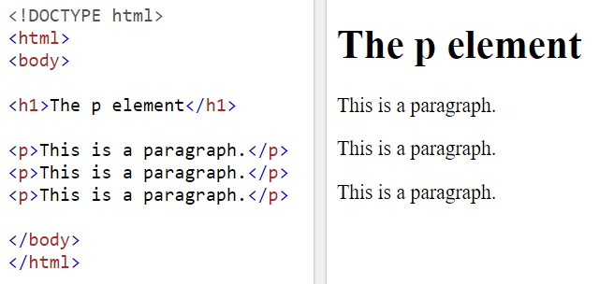
HTML Paragraph Tag <p>
The <p> tag defines a paragraph.
It is placed within the body of the web page
<p> is used to indicate the start of the paragraph.
</p> is used to indicate the end of the paragraph.
Browsers automatically add a single blank line before and after each <p> element.

Slide 13
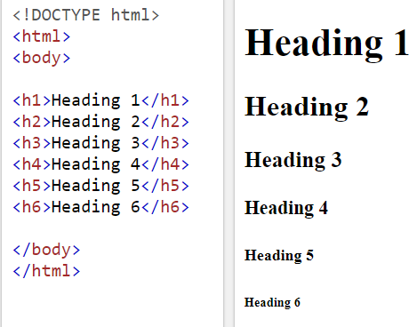
HTML Heading Tags <h1>, <h2>, ..., <h6>
HTML headings are defined with the <h1> to <h6> tags.
<h1> defines the most important heading. <h6> defines the least important heading.
<h1> headings should be used for main headings, followed by <h2> headings, then the less important <h3>, and so on.
These styles are predefined in the browser.

Slide 14
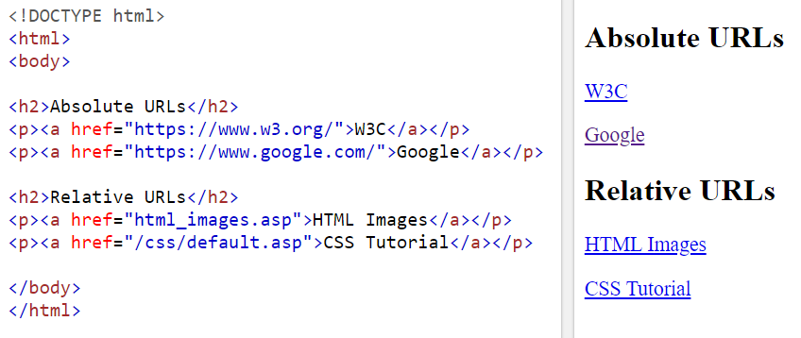
HTML Links <a> Tag
HTML links are hyperlinks.
The <a> tag defines a hyperlink, which is used to link from one page to another.
The most important attribute of the <a> element is the href attribute, which indicates the link's destination URL.
It can be absolute (to another web site) or relative (to another page on this site)
A local link (a link to a page within the same website) is specified with a relative URL (without the "https://www" part).

Slide 15
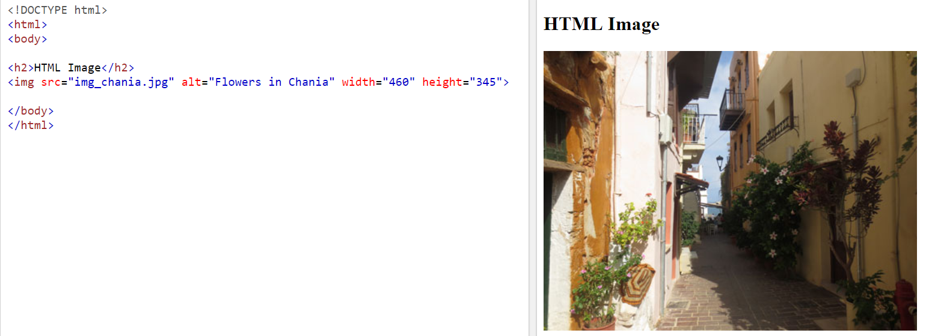
HTML Images <img> Tag
The <img> tag is used to embed an image in an HTML page.
Images are not technically inserted into a web page; images are linked to web pages. The <img> tag creates a holding space for the referenced image.
The <img> tag is empty, it contains attributes only, and does not have a closing tag.
The <img> tag has two required attributes:
src - Specifies the path to the image
alt - Specifies an alternate text for the image

Slide 16
HTML Image Path
It is a singleton tag, but you have to tell the web browser where to look for the image.
If the image is contained within the same folder or directory use the code:
<img src= “abc.jpg" width= "144" height= "50“ />
To display images from another folder in your web page:
<img src= "/images/abc.gif" width= "33" height= "32"/>
If the image is on another server, then the complete URL is given, providing that the user has permission to access that image.
<img src= "http://www.ecs.soton.ac.uk/images/abc.gif" />

Slide 17
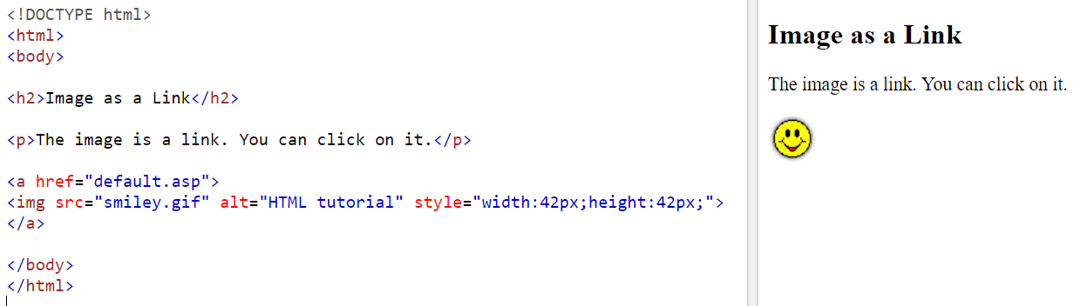
Image as a Link
To use an image as a link, put the <img> tag inside the <a> tag:

Slide 18
HTML Phrase Tags
The HTML phrase tags are special purpose tags, which defines the structural meaning of a block of text or semantics of text.
For example, abbr tag indicates that the phrase contained the abbreviation word.
Some examples of phrase tags are:
Abbreviation tag : <abbr>
Acronym tag: <acronym> (not supported in HTML5)
Marked tag: <mark>
Strong tag: <strong>
Emphasized tag : <em>
Definition tag: <dfn>
Quoting tag: <blockquote>
Short quote tag : <q>
Code tag: <code>
Keyboard tag: <kbd>
Address tag: <address>

Slide 19
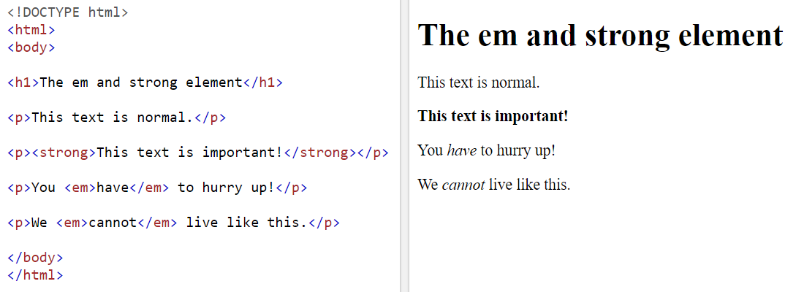
HTML Phrase Tags <em>, <strong>
The <em> tag is used to define emphasized text. The content inside is typically displayed in italic.
A screen reader will pronounce the words in <em> with an emphasis, using verbal stress.
The <strong> tag is used to define text with strong importance. The content inside is typically displayed in bold.

Slide 20
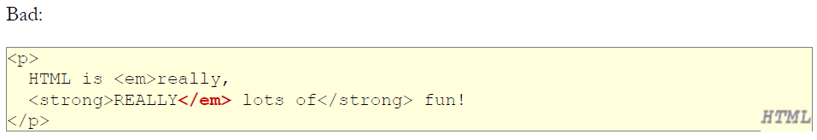
Nesting HTML Tags
HTML elements can be nested (this means that elements can contain other elements).
Tags must be correctly nested (a closing tag must match the most recently opened tag)
The browser may render it correctly anyway, but it is invalid XHTML.

Slide 21
HTML Lists
HTML lists allow web developers to group a set of related items in lists.
Unordered HTML List:
The HTML <ul> tag defines an unordered (bulleted) list.
An unordered list starts with the <ul> tag. Each list item starts with the <li> tag.
The list items will be marked with bullets (small black circles) by default.
Ordered HTML List:
The HTML <ol> tag defines an ordered list. An ordered list can be numerical or alphabetical.
An ordered list starts with the <ol> tag. Each list item starts with the <li> tag.
The list items will be marked with numbers by default.
HTML Description Lists:
HTML also supports description lists.
A description list is a list of terms, with a description of each term.
The <dl> tag defines the description list, the <dt> tag defines the term (name), and the <dd> tag describes each term.

Slide 22
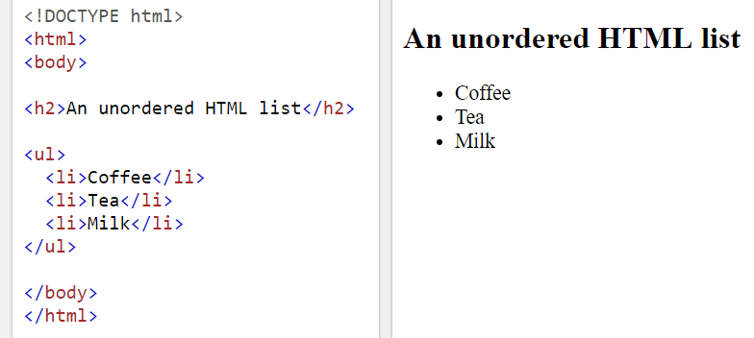
Unordered List Example

Slide 23
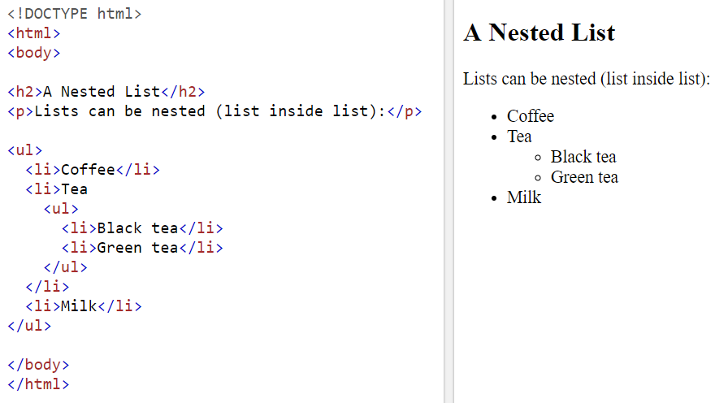
Nested Unordered List
Lists can be nested (list inside list):

Slide 24
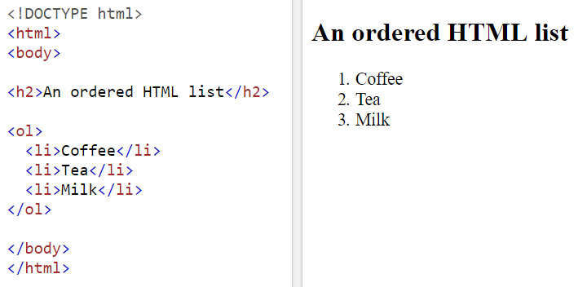
Ordered list Example

Slide 25
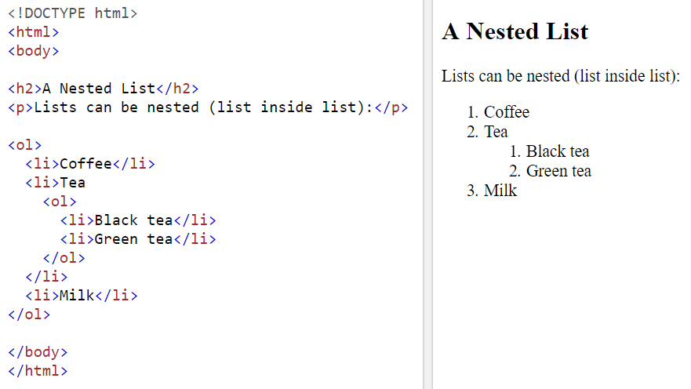
Nested Ordered List
Lists can be nested (list inside list):

Slide 26
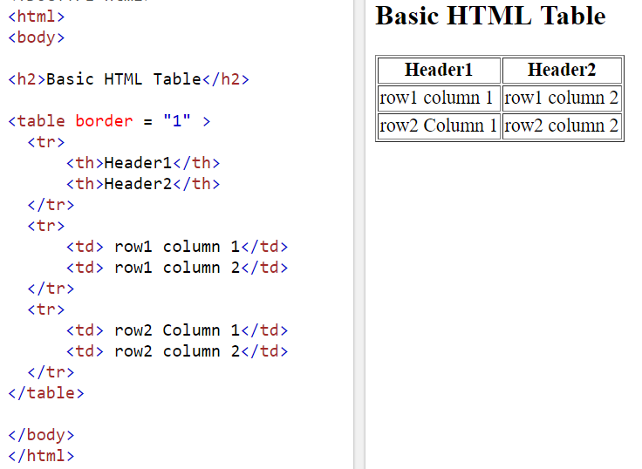
HTML Tables
The <table> tag defines an HTML table.
Each table row is defined with a <tr> tag. Each table header is defined with a <th> tag. Each table data/cell is defined with a <td> tag.
By default, the text in <th> elements are bold and centered.
By default, the text in <td> elements are regular and left-aligned.

Slide 27
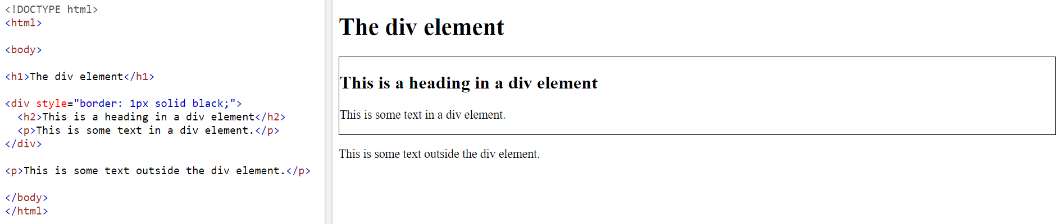
HTML <div> Tag
The <div> tag defines a division or a section in an HTML document.
The <div> tag is used as a container for HTML elements - which is then styled with CSS or manipulated with JavaScript.
The <div> tag is easily styled by using the class or id attribute.
Any sort of content can be put inside the <div> tag!
By default, browsers always place a line break before and after the <div> element.

Slide 28
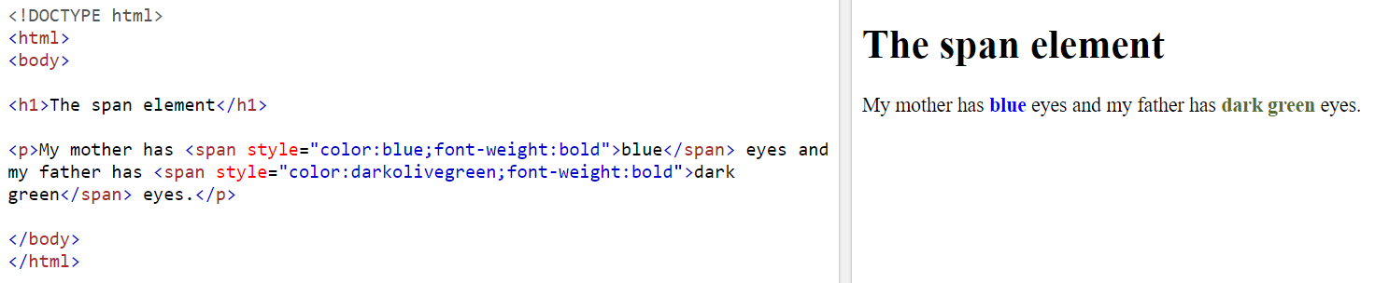
HTML <span> Tag
The <span> tag is an inline container used to mark up a part of a text, or a part of a document.
The <span> tag is easily styled by CSS or manipulated with JavaScript using the class or id attribute.
The <span> tag is much like the <div> element, but <div> is a block-level element and <span> is an inline element.

Slide 29
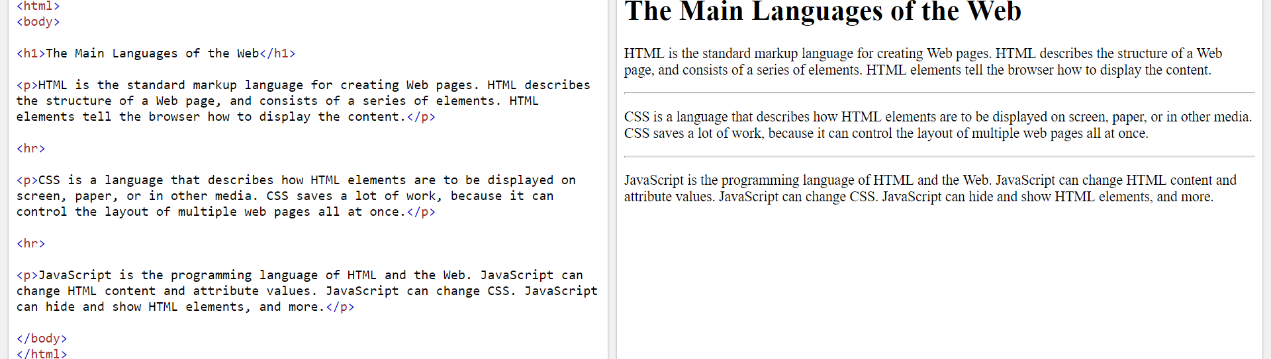
HTML Horizontal rule <hr> Tag
The <hr> tag defines a thematic break in an HTML page (e.g. a shift of topic).
The <hr> element is most often displayed as a horizontal rule that is used to separate content (or define a change) in an HTML page.
To specify width: <hr style="width:50%">
Or measured in pixels <hr style="width:50px">.

Slide 30
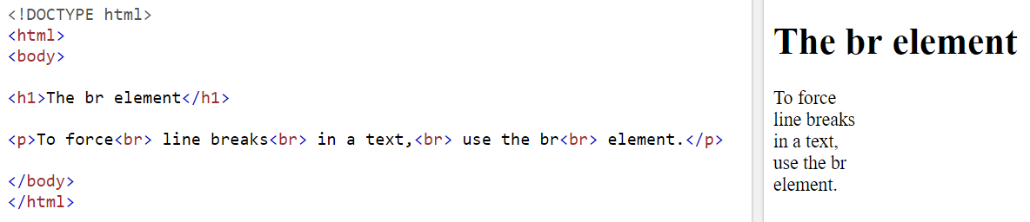
HTML <br> Tag
The <br> tag inserts a single line break.
The <br> tag is useful for writing addresses or poems.
The <br> tag is an empty tag which means that it has no end tag.

Slide 31
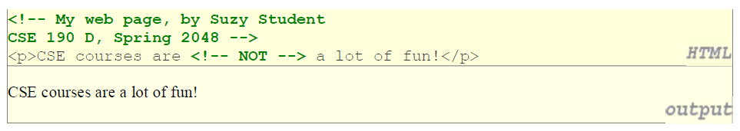
HTML Comments
HTML comments are not displayed in the browser, but they can help document your HTML source code.
You can add comments to your HTML source by using the following syntax:
<!– Write your comments here -->
Notice that there is an exclamation point (!) in the start tag, but not in the end tag.

Slide 32
Need to handle markup characters in content
To display a literal < or > in a document, use entities:
&lt; Displays <
&gt; Displays >
&amp; Displays &
&quot; Displays "
&nbsp; Nonbreaking space (won’t insert a line break at this space)
Many other entities are defined for special characters.
Whitespace is not significant except in a few cases (e.g. textarea, pre tags)

Slide 33
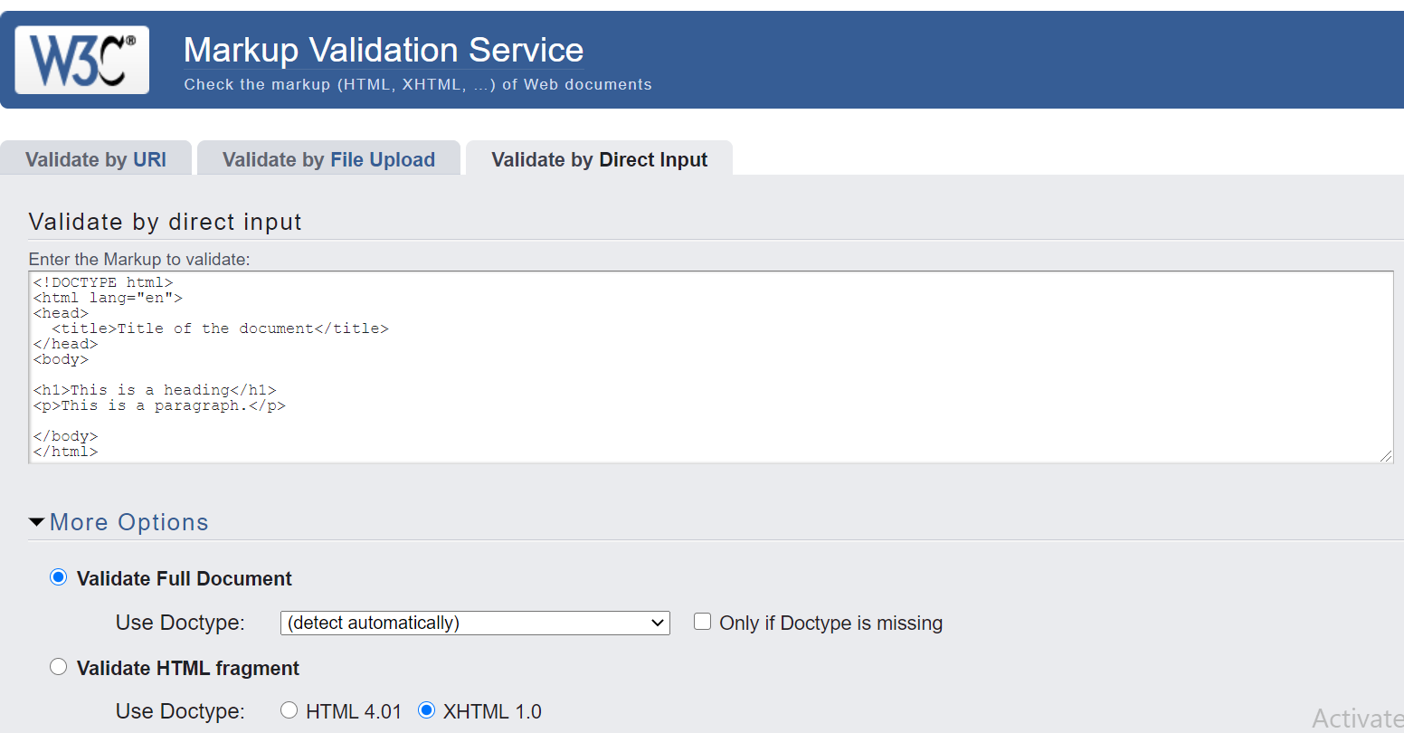
W3C Validator
This validator checks the markup validity of Web documents in HTML, XHTML, etc.
It is a W3C service to ensure that the tags conform to the standard.

Slide 34
Another markup language: Markdown
# Heading
## Sub-heading
### Another deeper heading
Paragraphs are separated
by a blank line.
Two spaces at the end of a line leave a
line break.
Text attributes _italic_, *italic*, __bold__, **bold**,
`monospace`.
Horizontal rule:
---
Bullet list:
* apples
* oranges
* pears
Numbered list:
1. apples
2. oranges
3. pears
A [link](http://example.com).

Slide 35
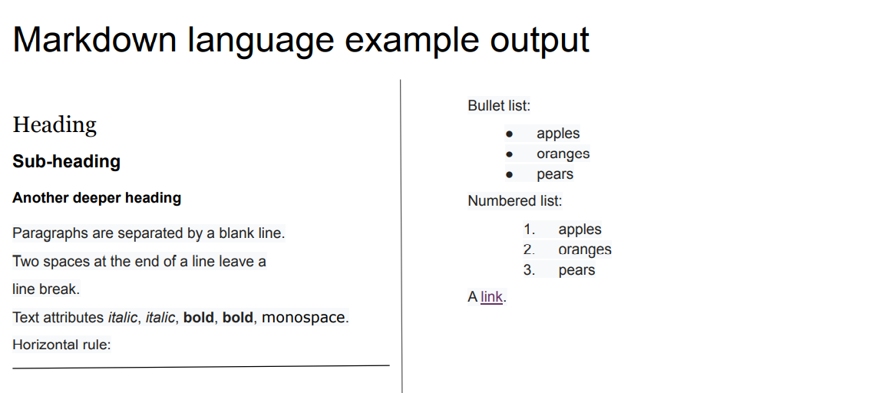
Markdown

Slide 36
Summary of Today’s Lecture
HTML Introduction
HTML and XHTML
HTML Elements
Block level vs Inline Elements
HTML Page Structure
Example HTML Tags
HTML Validator

Slide 37
References
https://developer.mozilla.org/en-US/docs/Web/HTML
https://www.w3schools.com/html/

